Slide 1
Exploring Strategies and Opportunities In Professional Development
MAY 24 | 1:00 PM ET
Tessa S. Cook, MD, PhD, CIIP
Sylvia Devlin M.S. RT (R)(M)(QM), CIIP
Nikki Fennell, CIIP
Peter A. Harri, MD
Robert A. Paul, MBA, CIIP
Nabile Safdar, MD, MPH

Slide 2
Disclosure(s)
Insert Disclosures or note “No disclosures”

Slide 3
DELETE THIS SLIDE BEFORE UPLOAD
Please note: this PPT does have animations, but no timing requirements among the slides. Feel free to edit these as you see fit.
We would like to ensure everyone in the audience is able to understand your presentation. When submitting, please make sure the ‘Always Use Subtitles’ feature is turned on (under the Slide Show tab)
Notes:
FYI

Slide 9
@FINAL SESSION PRESENTER – UPDATE + INCLUDE COMPLETE THE NEXT SLIDE
Participants looking to claim CE must complete a session survey. Attendees claiming RT Credits for this session must enter a verification of attendance code while taking the session survey.
The LAST presenter should update + include the next slide at the end of their presentation. SIIM Staff will distribute these codes closer to the meeting. A list will also be provided in the Speaker Ready Room.
Display on screen PRIOR to Q&A and leave up until “Thank You”
REMOVE THIS SLIDE FROM DECK. NON-FINAL SPEAKERS SHOULD REMOVE THIS + THE CLAIM CREDITS SLIDE.

Slide 10
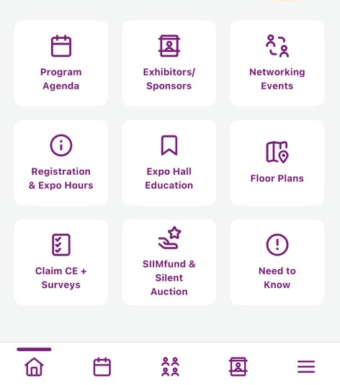
How to claim your CE/CME Credits
Add this session to My Schedule in the Meeting App
Select Claim CE + Surveys
OR select Survey at the bottom of the Session Details page.
Technologists (RT) MUST use code
Complete the survey before June 16
Allow 6-8 weeks for processing
Session ID: ####
RT Code: ###

Slide 11
Thank You for Attending!

